Slide 1
Week8 Group 3
Project Progress
Presenter Haozhe Zhang

Slide 2
Group 3 - DayDream
Project: Web platform for Client-Suppiler Business Management
Group Member:
Front-end developers:
Tiansheng Liu 470342488
Fengjun Li 470342112
Yinan Chen 470041259
Kewen Su 470503539
Back-end developers:
Trung Kien Hoang 470020243
Xiaohan Li 470011746
Haozhe Zhang 460335162

Slide 3
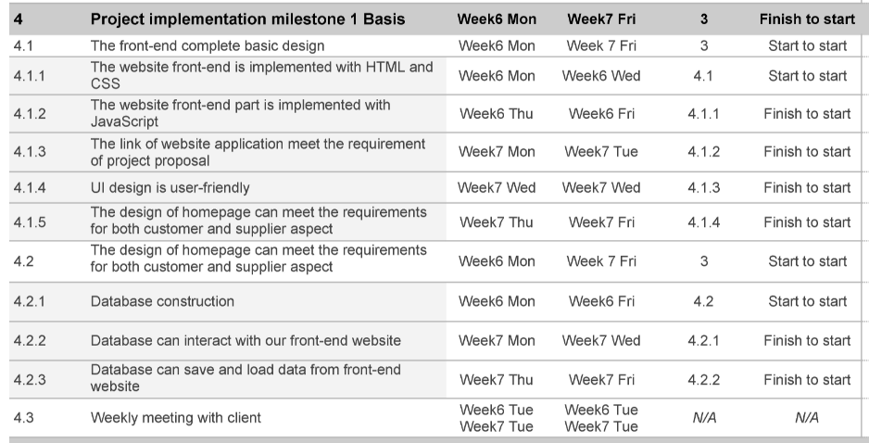
Project Strategy and schedule
Our Project Strategy: Agile.
Base on our client’s feedback last week’s schedule is mostly same as the original schedule

Slide 4
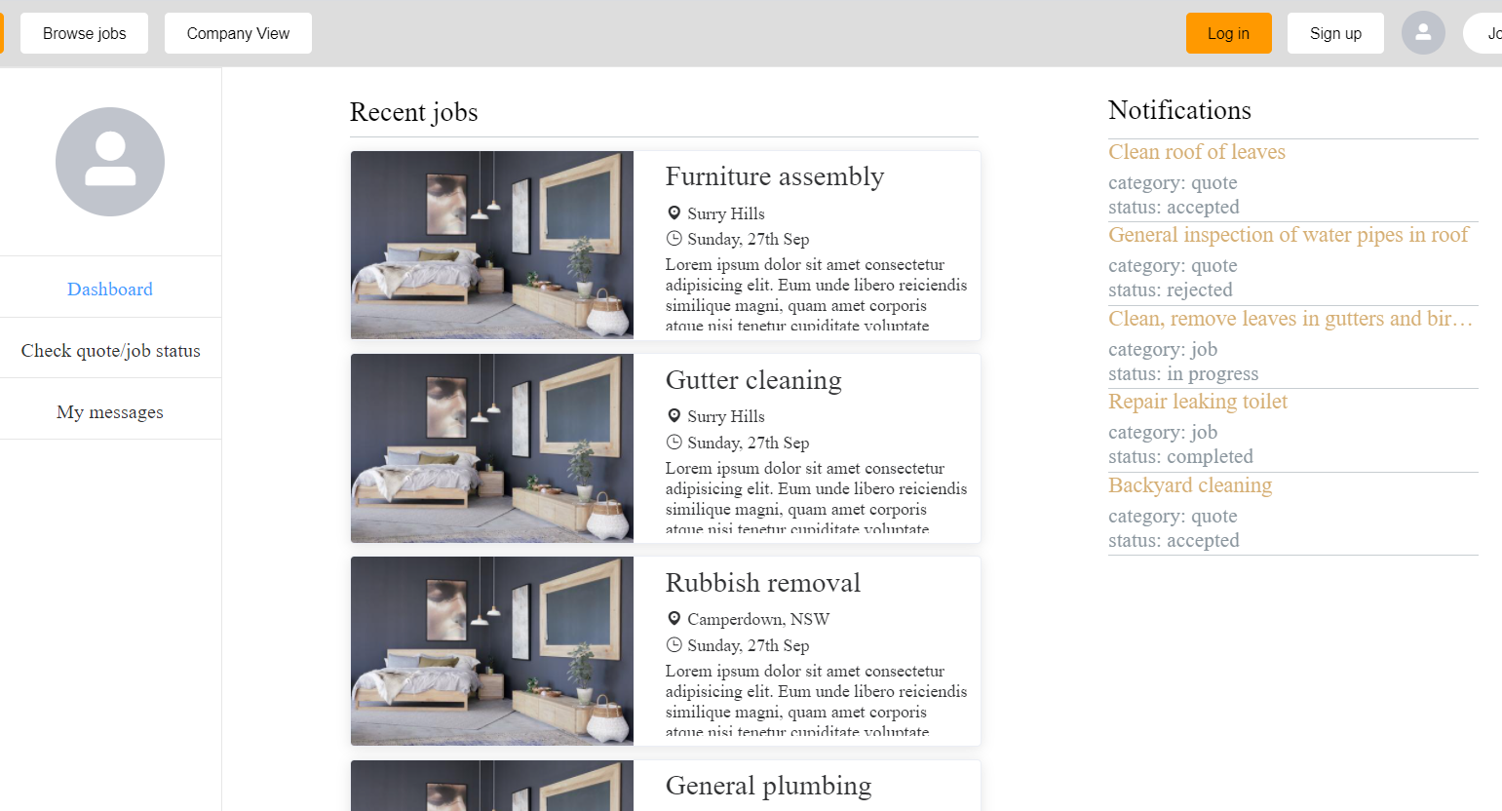
Front-end Development Progress
Our front-end team has complete most of static webpage design last week

Slide 5
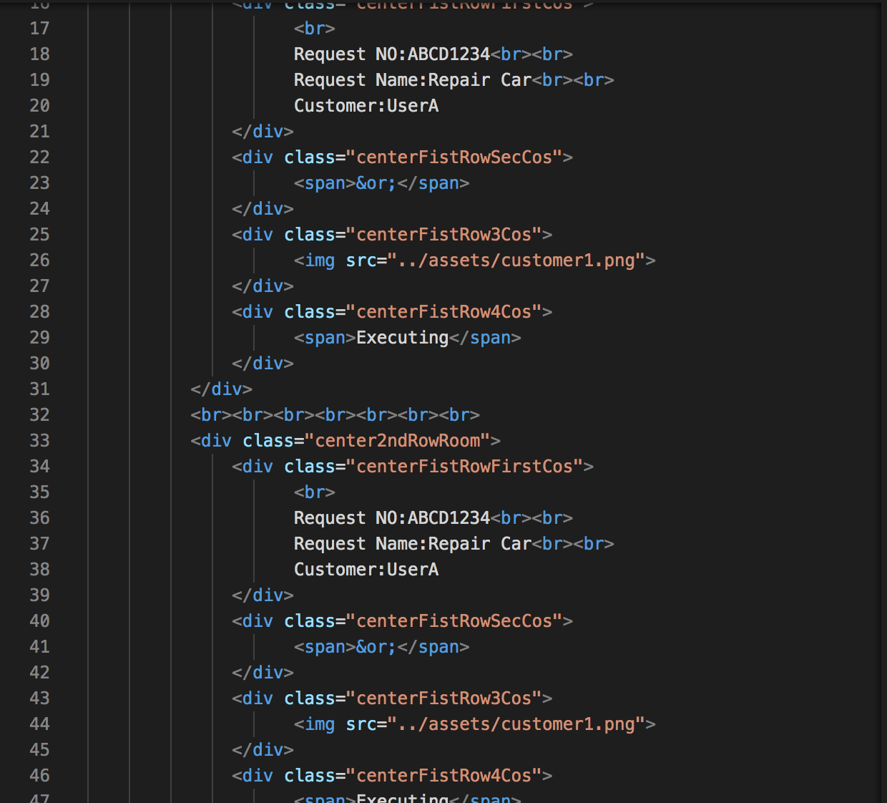
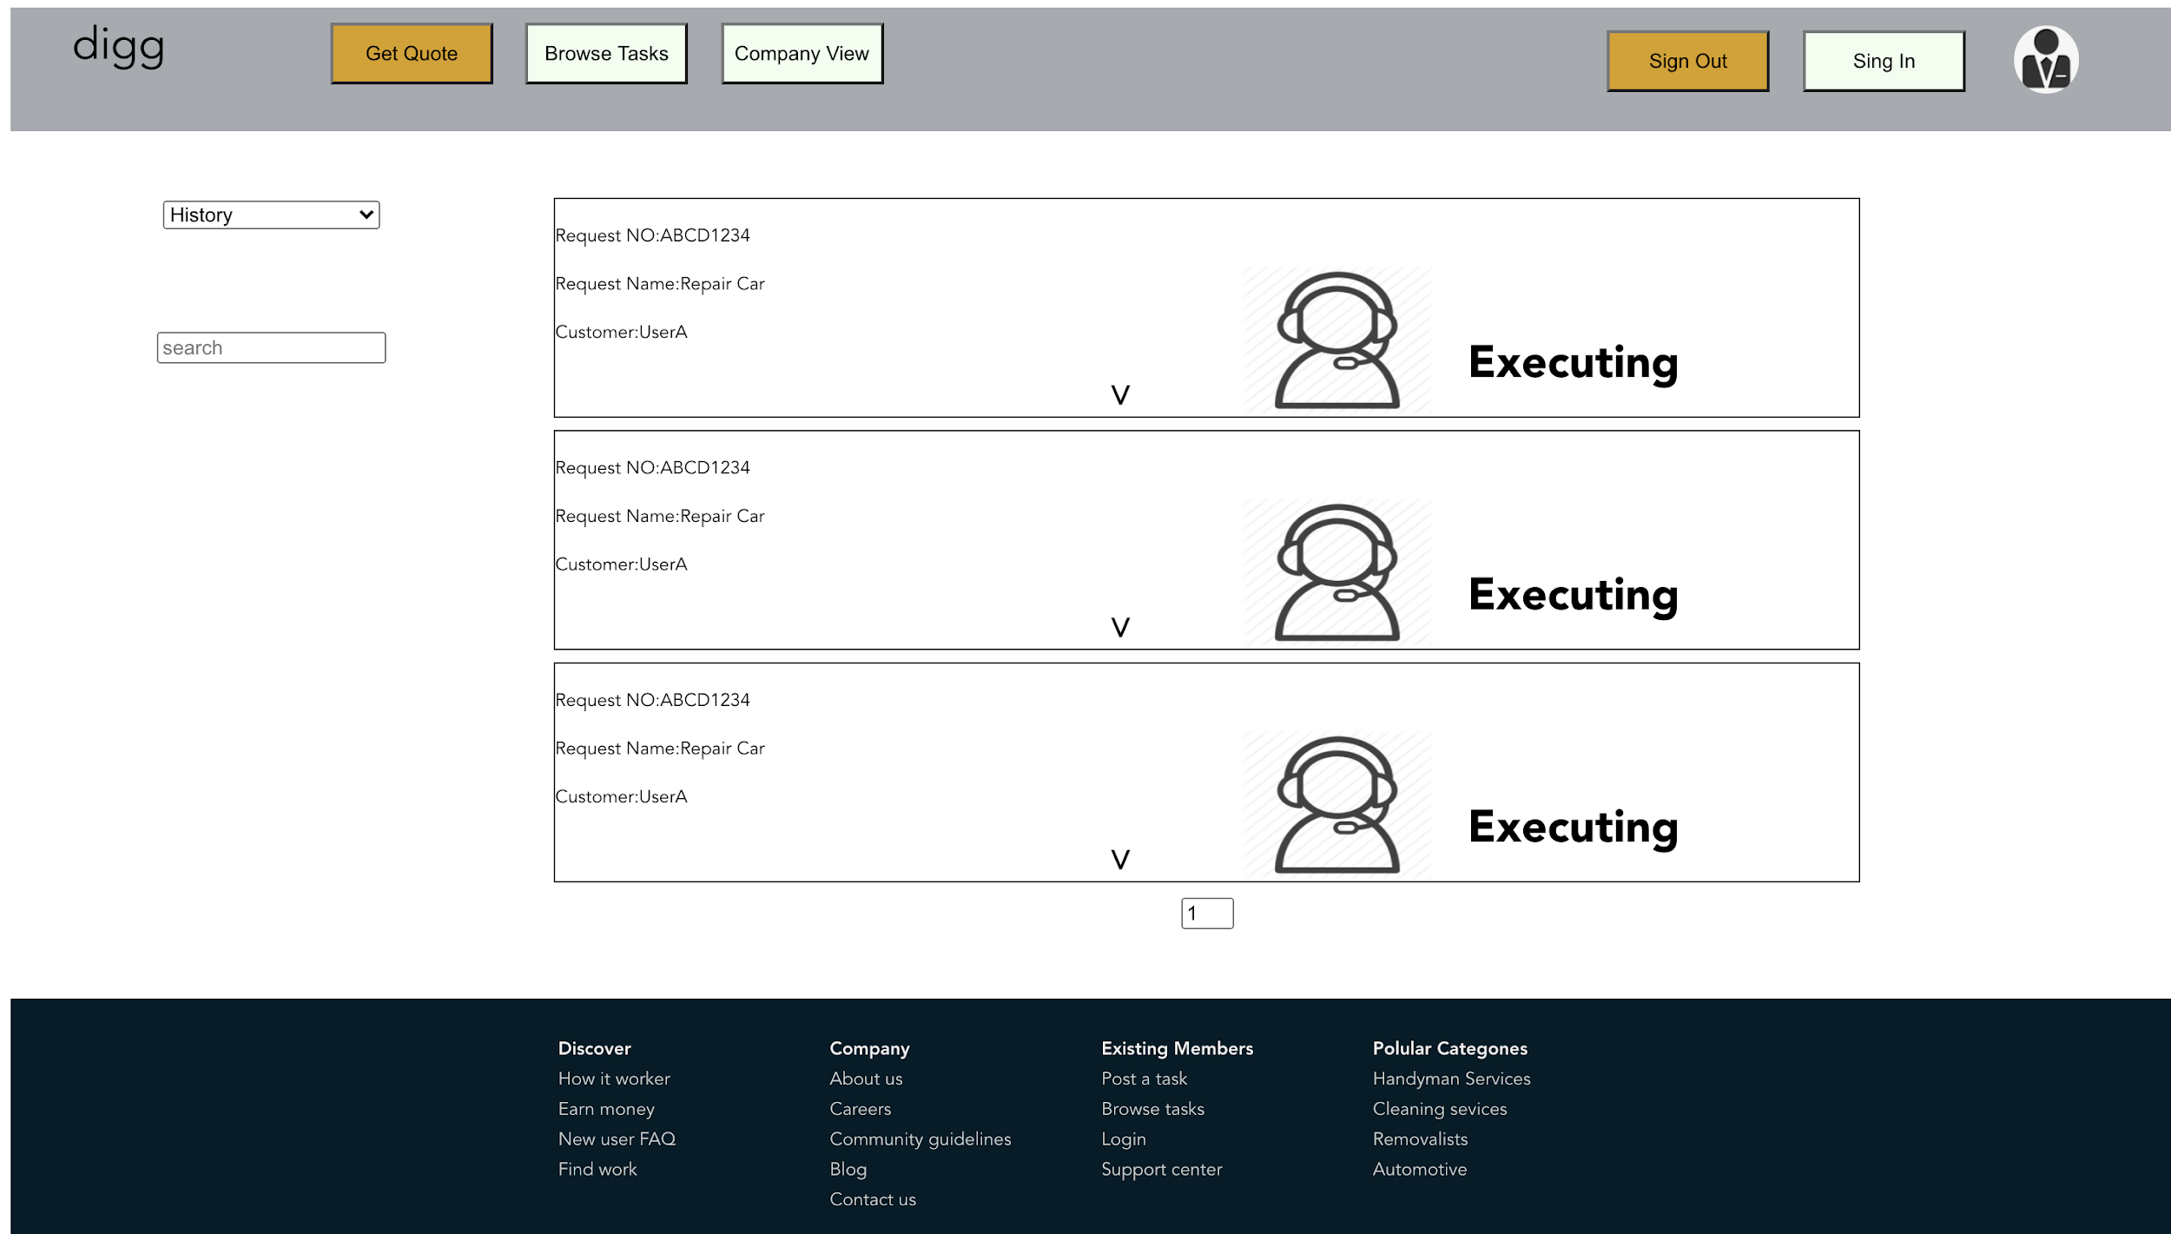
Front-end Development Progress
Next Step we plan to finish static page design in this week

Slide 6
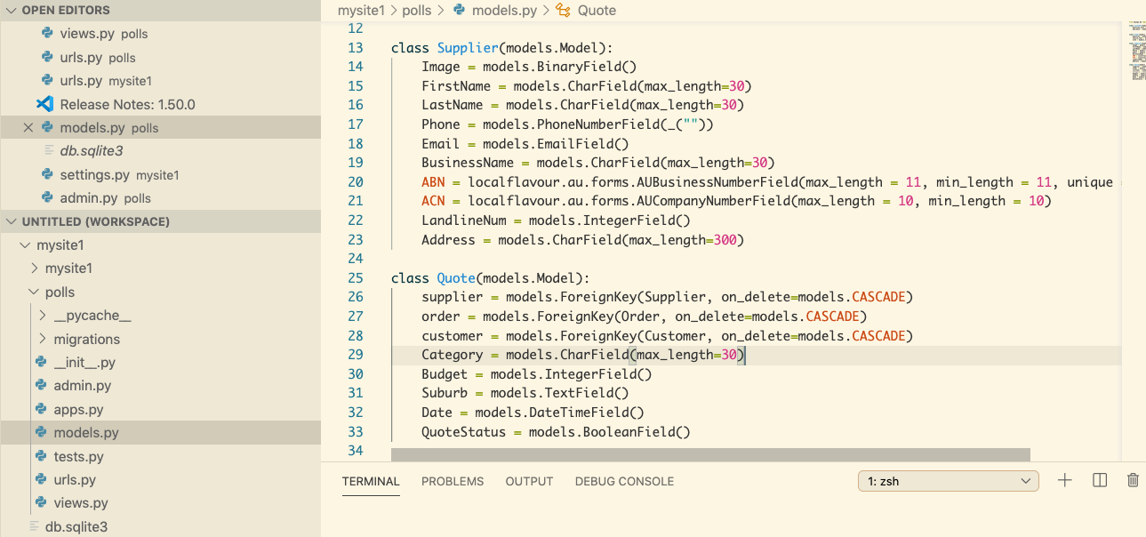
Back-end Development Progress
Django enviroment setup
Back-end github built up
Complete a simple model

Slide 7
Problem during our development
Lack of knowledge and experience in back-end development
Lack of Django development experice
The computer language that group members handle are not uniform
The information exchange between group members in low efficient
There is a gap in the work progress,causing the project to stagnate
Online information exchange is inefficient

Slide 8
And how we solve the Problem& Team dynamics
Face to Face meeting
High efficiency
Flexible for group development
Find more tutorial resource
Can save a lot of time during development.

Slide 9
THANK YOU!

